Slide 1

NBKR Institute of Science and Technology, Vidyanagar (Autonomous) Department Computer Science and Engineering
Final Year Project on
Web-Based Predictive Analytics System For Stock Market Trends
BY 22PR001 (Batch-01)
G. Anusha - 22KB1A0546
P. Sowmya Sree - 22KB1A05E5
S. Navya Sri - 22KB1A05G8
Under the esteemed Guidance of :
Dr.A.Rajasekhar Reddy
M.Tech, Ph.D
Professor & HOD of CSE Department

Slide 2
ABSTRACT
The stock market is a highly complex nonlinear movement system, and its fluctuation law is affected by many factors, so the prediction of the stock price index is a very challenging task. In Stock Market Prediction the aim is to predict the future value of the financial stocks of a company. Machine learning itself employs different models to make prediction easier. Algorithms like Long short-term memory(LSTM) which is a deep learning algorithm is best algorithm for stock price prediction because of its sequential data. Using layers like dropout and dense will enhance the performance and accuracy of the model.

Slide 3
INTRODUCTION
ML has a subset known as Deep learning. It is a specialized subset of machine learning that utilizes neural networks with multiple layers to model complex patterns in large datasets.
Deep learning algorithms are advanced machine learning techniques that utilize neural networks with multiple layers to process and learn from vast amounts of data.
In present generation stock market plays an important role in global economy, serving as a platform for companies to raise capital and for investors to grow their wealth.
Predicting the stocks is a challenging task and the data is very much complex. machine learning is a powerful tool in predicting the future outcomes using algorithms with accurate results.

Slide 4
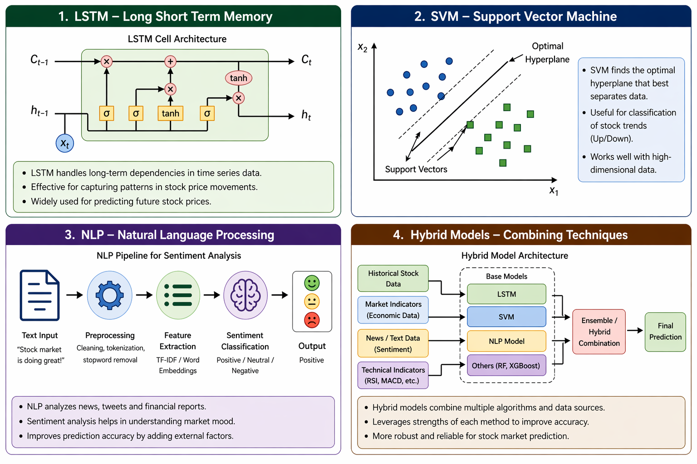
LITERATURE SURVEY

Slide 5
EXISTING SYSTEM
The existing system of stock price prediction uses a feed forward neural network.
This model performs backpropagation algorithm for training process.
This model gave a fundamental insight into the prediction trend and provided a graphical result on how the prediction should look.
Even though it can give an accuracy of 97.66% but it loses the context from time series data very fastly and requires a large training data and epochs to get the above accuracy.

Slide 6
DRAWBACKS OF EXISTING SYSTEM
LARGE DATASET: The existing model requires a large dataset, many training and epochs to gain the perfect accuracy of the stock trends and it can’t predict the sequential nature of time-series data.
OVERFITTING: These models are prone to overfitting as the model is complex and has to learn too much from training data making it sensitive to some specific details causing overfitting.
SCALABILITY: This model struggle with scalability when dealing with large-scale sequential data, as they do not inherently account for temporal dependencies.

Slide 7
PROPOSED SYSTEM
In contrast, the proposed system uses a deep learning algorithm known as LSTM and layers like dense and dropout.
This model can capture the temporal dependencies, long term patterns and can handle sequential data effectively.
This model can easily get adapted to dynamic market conditions and automatically learn relevant features from raw data.
LSTM-model will outperform the existing model in stock price prediction due to its capabilities and abilities.

Slide 8
ADVANTAGES OF PROPOSED SYSTEM
Handling Sequential Data: LSTM are specifically designed to handle sequential data, such as time series. so, they can easily find long term patterns in data which is crucial for stock price prediction.
Feature Learning: The proposed model can automatically learn relevant features from raw sequential data, reducing need for extensive feature engineering.
Memory and Context: LSTM’s have a memory cell that can retain information over long periods allowing them to remember important past events and use this context to make better predictions.

Slide 9
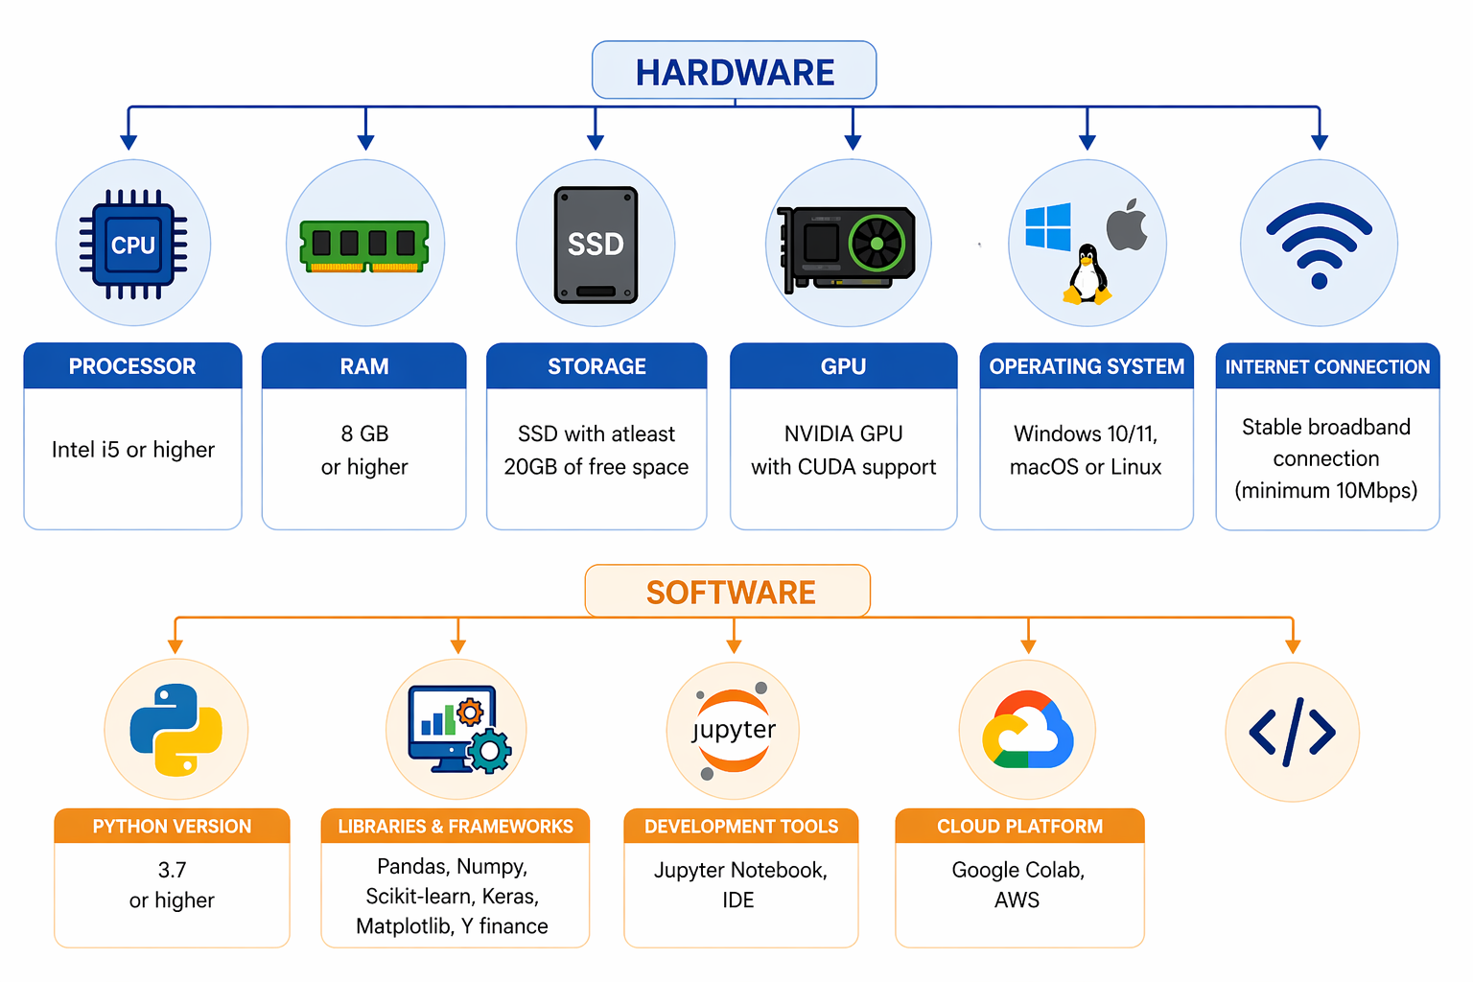
SYSTEMS ARCHITECTURE

Slide 10
METHODOLOGY
1.Data Fetching :
Algorithm: i)Yahoo Finance API (y finance)
ii)Pandas for storing and organizing the fetched data
Purpose: Fetches real-time stock data (e.g., historical prices, volume) up to the current date.
Output: CSV or Data Frame containing historical stock prices (e.g., Open, High, Low, Close, Volume).
2. Data Preprocessing :
Sliding Window: Creates sequences of data for LSTM input using a sliding window approach.
Purpose: Prepares the data for training the LSTM model.
Tools/Libraries: Pandas for data cleaning.
NumPy for reshaping data.
Scikit-learn for scaling and splitting data.

Slide 11
3.Training and Validation :
Algorithm: Gradient Descent (via Adam optimizer)
Purpose: Trains the LSTM model on historical stock data and validates its performance.
Tools/Libraries: Keras for model training and validation.
Matplotlib for visualizing training and validation loss.
4.LSTM (Long Short-Term Memory) Network:
Purpose: LSTM is a type of Recurrent Neural Network used for sequential data, such as time series forecasting (stock prices in this case).
LSTM is particularly suited for time-series prediction because it can remember long-term dependencies, making it effective for predicting future values based on historical data.
The LSTM model in this project contains some layers in order to run the model without any blunders.
LSTM Layer: This is the core layer that helps capture time-dependent patterns in stock price data.

Slide 12
Dropout Layer: Helps in regularizing the model to prevent overfitting by randomly dropping some of the neurons during training.
Dense Layer: This layer provides the final output for predicting the next stock price.
5.Evaluation Metrics :
Algorithms:
Mean Absolute Error (MAE): Measures the average absolute difference between predicted and actual prices.
Root Mean Squared Error (RMSE): Measures the square root of the average squared difference between predicted and actual prices.
Purpose: Evaluates the accuracy of the model's predictions on historical data.
6. Search Functionality :
Algorithm: String Matching
Purpose: Allows users to search for stocks by name or symbol.

Slide 13
MODULES
1.Data fetching & manipulation :
y finance (Yahoo Finance)
Purpose: To fetch real-time stock data.
Pandas (Data manipulation)
Purpose: For handling data, specifically for Data Frames, and time series data.
2.Data preprocessing:
Num Py (Numerical operations)
Purpose: Used for efficient array handling , especially for data preprocessing
and transformations
Sklearn (Scikit-learn)
Purpose: For data preprocessing and evaluation metrics.
3.Training & validation
Keras (Deep learning)
Purpose: For building and training the LSTM model.
Matplotlib (Plotting)
Purpose: To visualize data and plot graphs such as loss curves and predicted stock
prices.

Slide 14
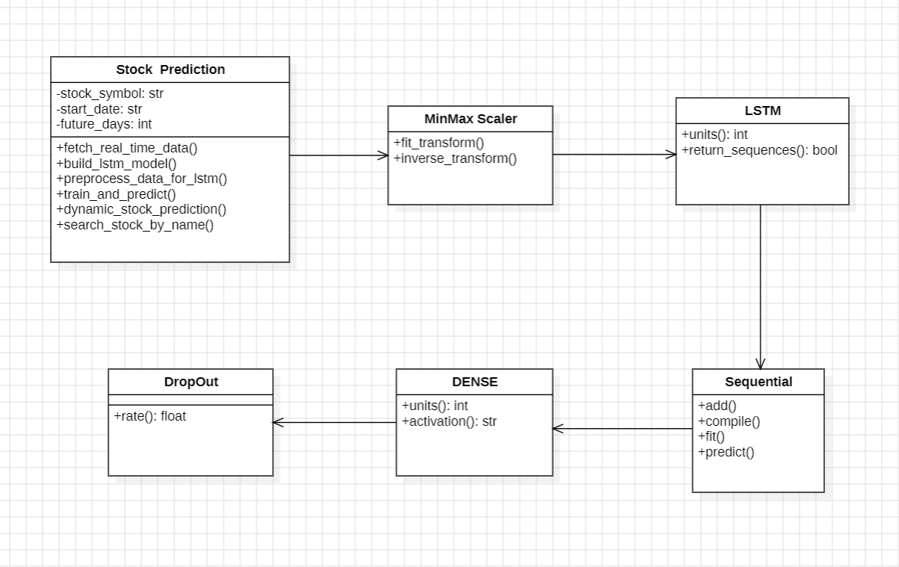
CLASS DIAGRAM

Slide 15
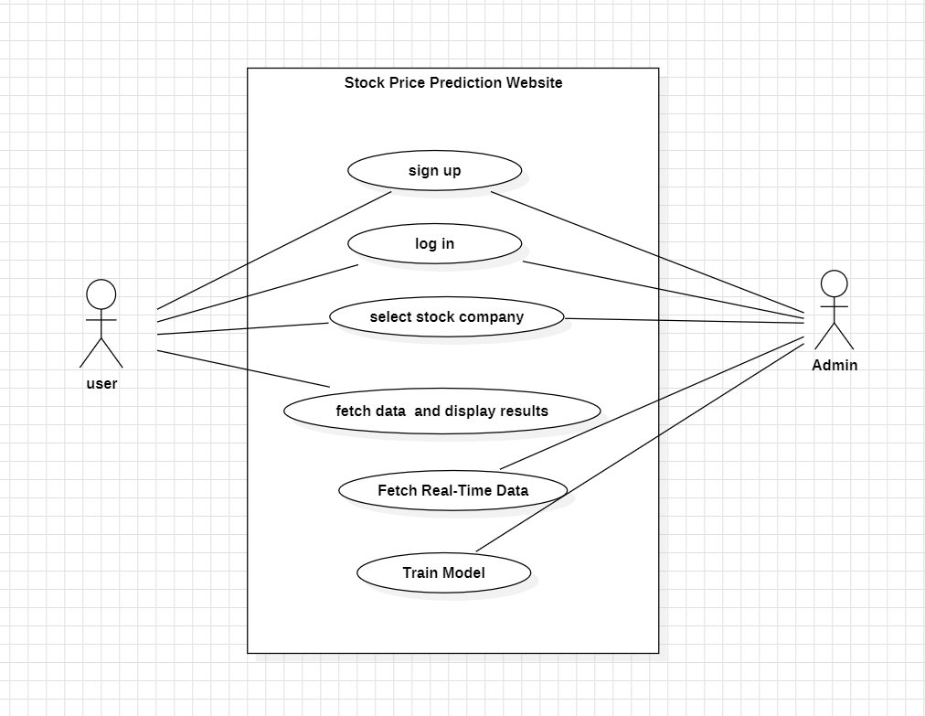
USE CASE DIAGRAM

Slide 16
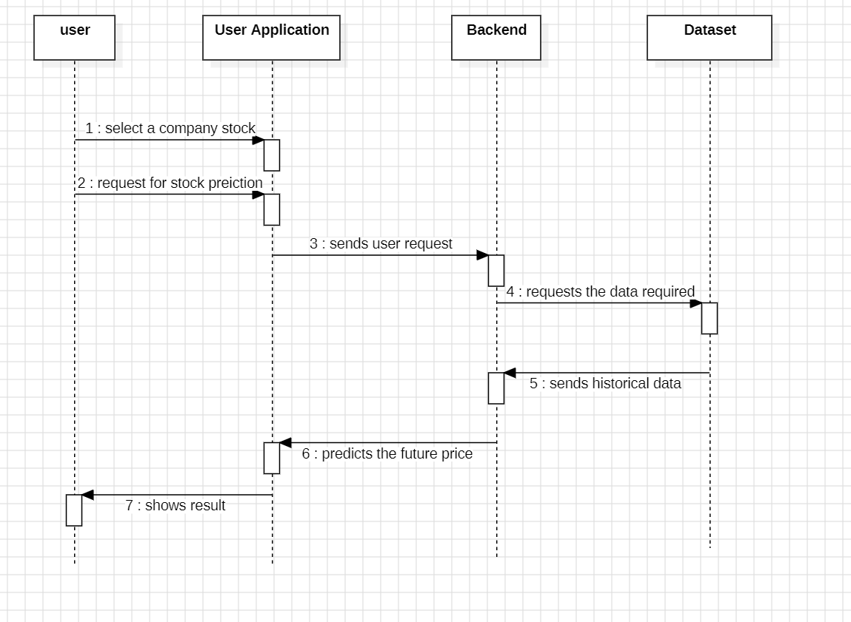
SEQUENCE DIAGRAM

Slide 17
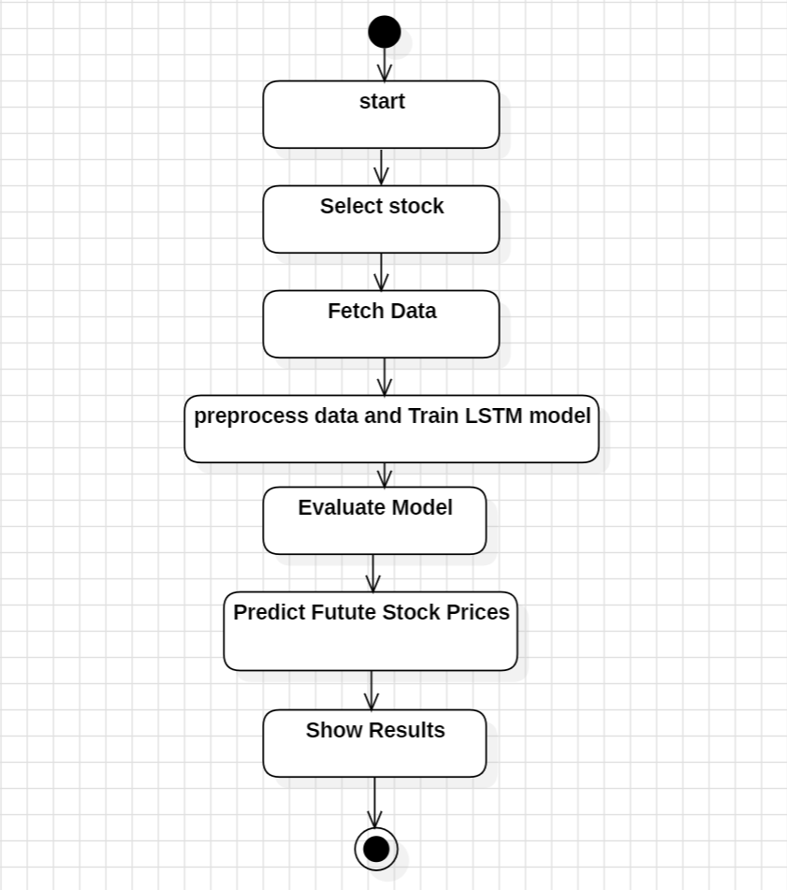
ACTIVITY DIAGRAM

Slide 18
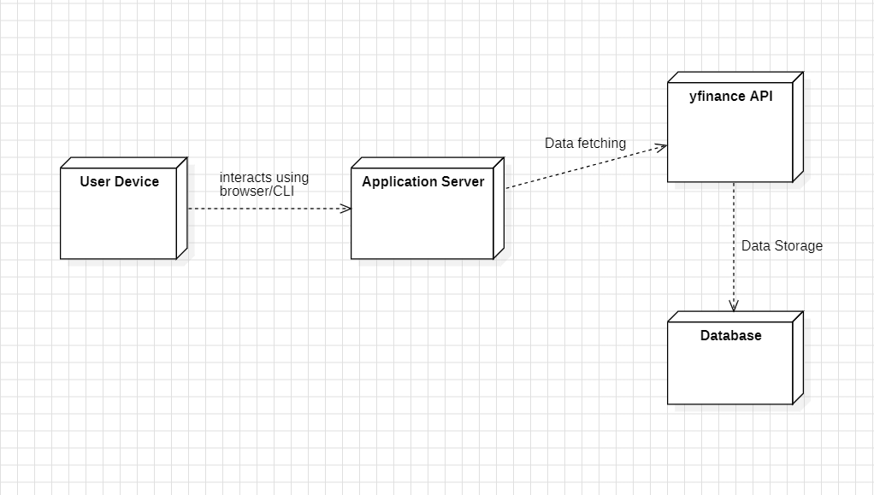
DEPLOYMENT DIAGRAM

Slide 19
SAMPLE CODE SNIPPET
class StockPredictor:
def predict_price(self, data, scaler, days):
# LSTM based prediction
X, y = [], []
lookback = 30
for i in range(lookback, len(data) - days):
X.append(data[i-lookback:i, 0])
y.append(data[i:i+days, 0])
X, y = np.array(X), np.array(y)
X = X.reshape((X.shape[0], X.shape[1], 1))
model = Sequential([
LSTM(50, return_sequences=True),
LSTM(50),
Dense(days)
])
model.compile(optimizer='adam', loss='mse')
model.fit(X, y, epochs=5, verbose=0)
last_data = data[-lookback:].reshape(1, lookback, 1)
pred = model.predict(last_data)
return scaler.inverse_transform(pred.reshape(-1, 1))

Slide 20
DATA FETCHING & UI
# Fetch stock data
data = yf.download(symbol, period="2y")
# Extract closing prices
close = data[['Close']].values
# Scale data
scaler = MinMaxScaler()
scaled_data = scaler.fit_transform(close)
# Predict
predictions = predict_price(scaled_data, scaler, days)
# Display results
st.line_chart(predictions)
st.metric("Last Price", close[-1][0])
st.metric("Predicted", predictions[-1][0])

Slide 21
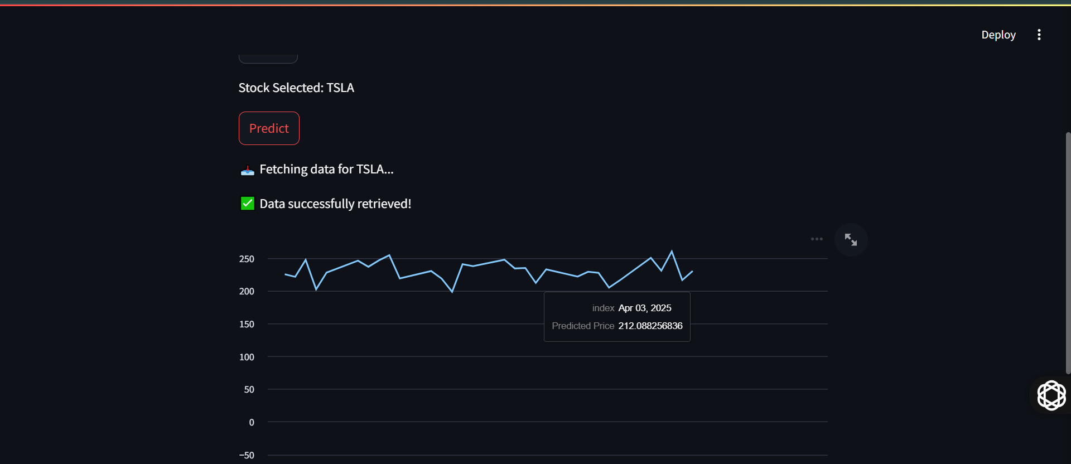
RESULT

Slide 22
CONCLUSION
In this project, we implemented an LSTM-based model for predicting stock prices and layers like dropout for preventing the overfitting. Through careful data preparation and model training, we aimed to enhance the accuracy of our predictions and provide accurate prices of stocks for investors.
Overall, LSTM for stock price prediction highlights the potential of deep learning techniques in financial forecasting and accurate prediction of stocks

Slide 23
FUTURE ENHANCEMENTS
Sentiment Analysis: Using news headlines, social media trends and financial reports to gauge market sentiment and refine predictions.
Hybrid Models : Combining LSTM with other deep learning models like CNN or Transformer-based architectures for better feature extraction.
Cross-Market Analysis: Expanding the model to predict stock prices across multiple markets for diversified insights.

Slide 24
THANK YOU

